Slide 1

Exploratory Data Analys on Rental Properties

Slide 2
About me
I have Pursed my Master’s in Data Science at Essex University, Colchester, UK.
I have successfully completed 3 months of Internship from Myupdate24.
As a Data Analyst with hands-on experience in Internship, I have implemented technique like data cleaning, analysis, and visualization. Strong proficiency in SQL, Python, Excel, and Power BI to extract insights, build dashboards, and support data-driven decision-making. Adept at translating complex data into clear business insights.
Also looking forward to learn more in the field of Data Science and Agentic AI.
Looking of opportunities where I can implement my skills.

Slide 3
Objective of the data and web scraping details
Objective : Analysis on Rented Properties in 5 Major Indian Metros (Bangalore, Chennai, Hyderabad, Mumbai, and Pune).
Web Scraping details:
Conducted analysis of rented properties using data scraped from the MagicBricks real estate website.
Used Python web scraping techniques with BeautifulSoup to extract rental listings, prices, locations, and property details.
Cleaned and structured raw HTML data into a usable dataset for analysis using Regex.
Summary of the Data:
I have collected the data of about 1233 rows and 13 columns from 5 major cities from the website.
Each record includes features: BHK, Price, Area, Furnishing, Facing, Tenant Type, and more.

Slide 4
Exploratory Data Analysis:
Data Cleaning and Data Manipulation Steps:
Standardized text values: Converted price strings like '2.3 Lac' into numeric 230,000.
Regex extraction: Isolated square footage from complex text formats.
Standardization: Cleaned neighborhood names and aligned categorical values.
Imputation: Filled missing values in 'Facing' and 'Locality' using city-specific mode frequencies.
Extracting floor number from total floors
Extracting location and area from the column

Slide 5
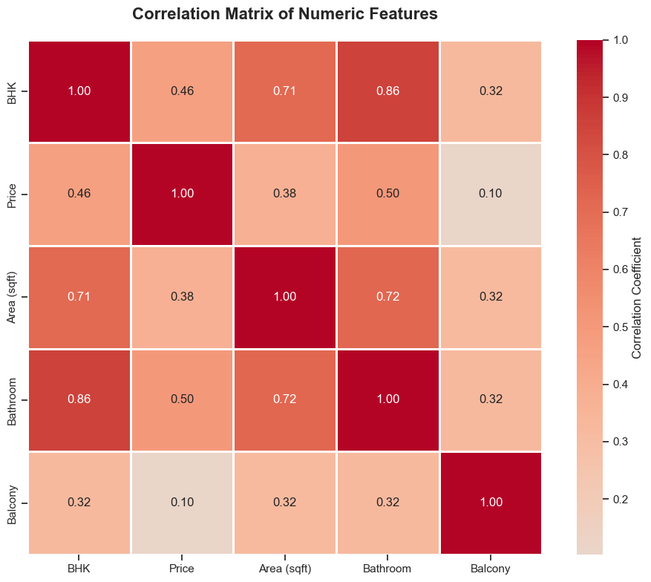

Slide 6
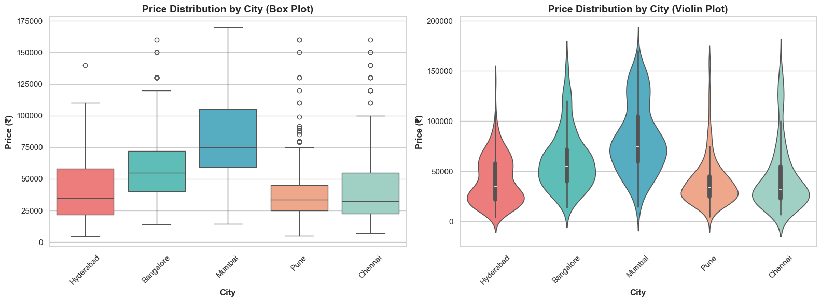
Price Distribution Comparison Analysis

Slide 7
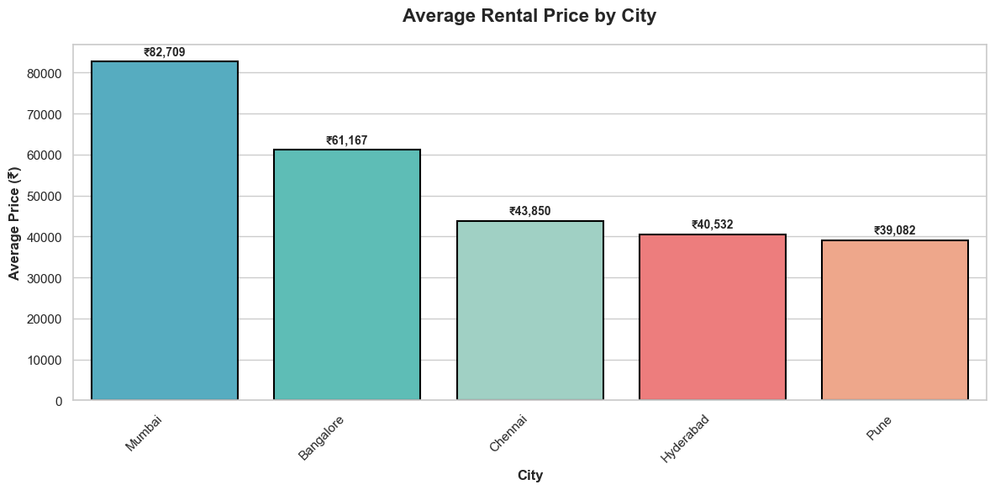
Rental Price Distribution by City

Slide 8
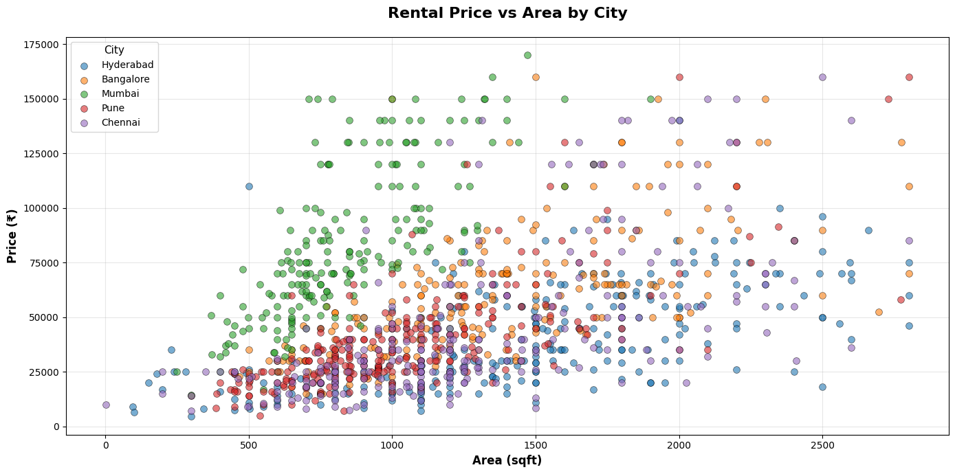
Rental Price vs Area Analysis

Slide 9
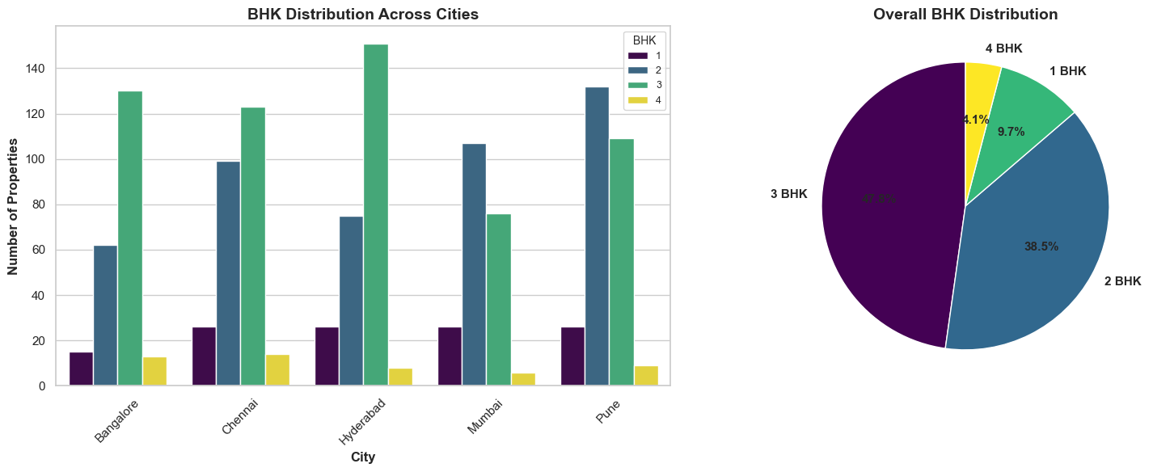
3 BHK Distribution Analysis

Slide 10
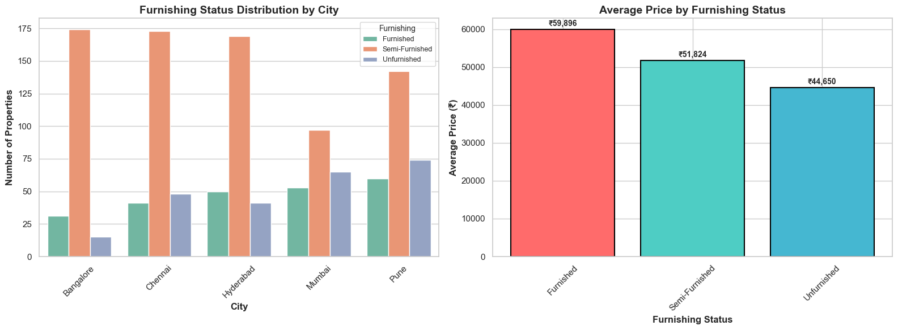
Furnishing Status Analysis

Slide 11
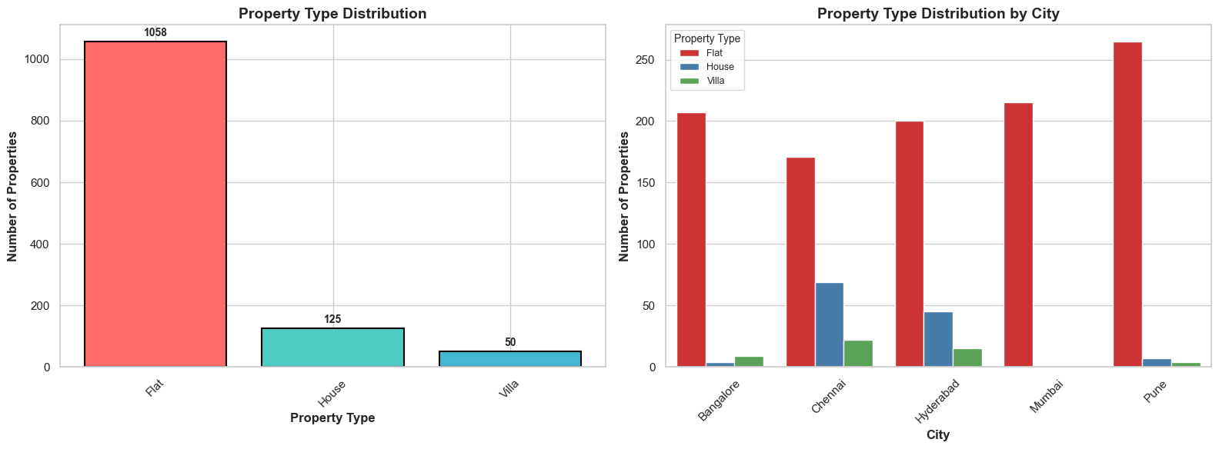
Property Type Distribution Analysis

Slide 12
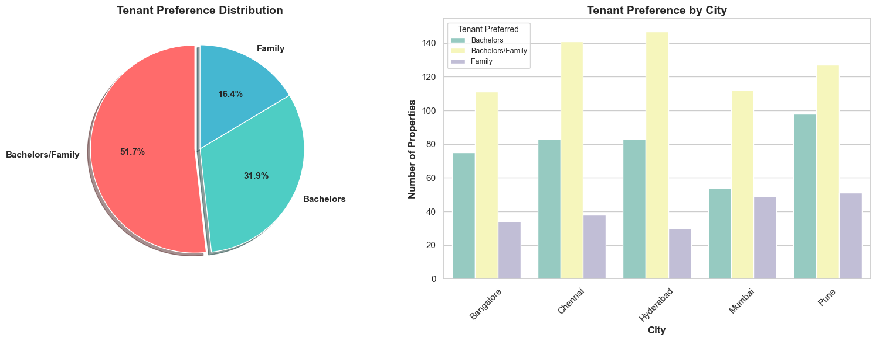
Tenant Preference Analysis

Slide 13
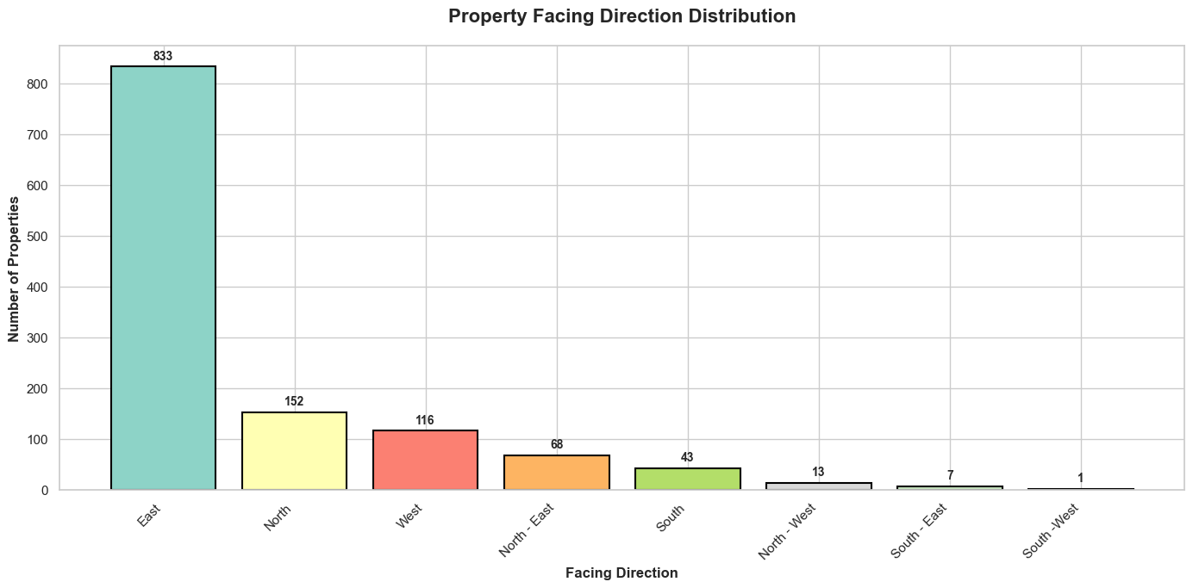
Property Facing Direction Analysis

Slide 14
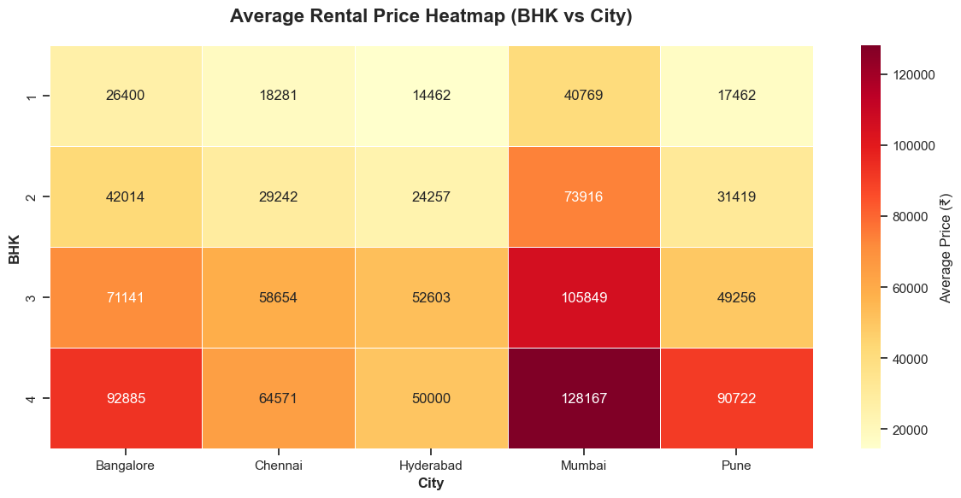
Average Rental Price Heatmap (BHK vs City)

Slide 15
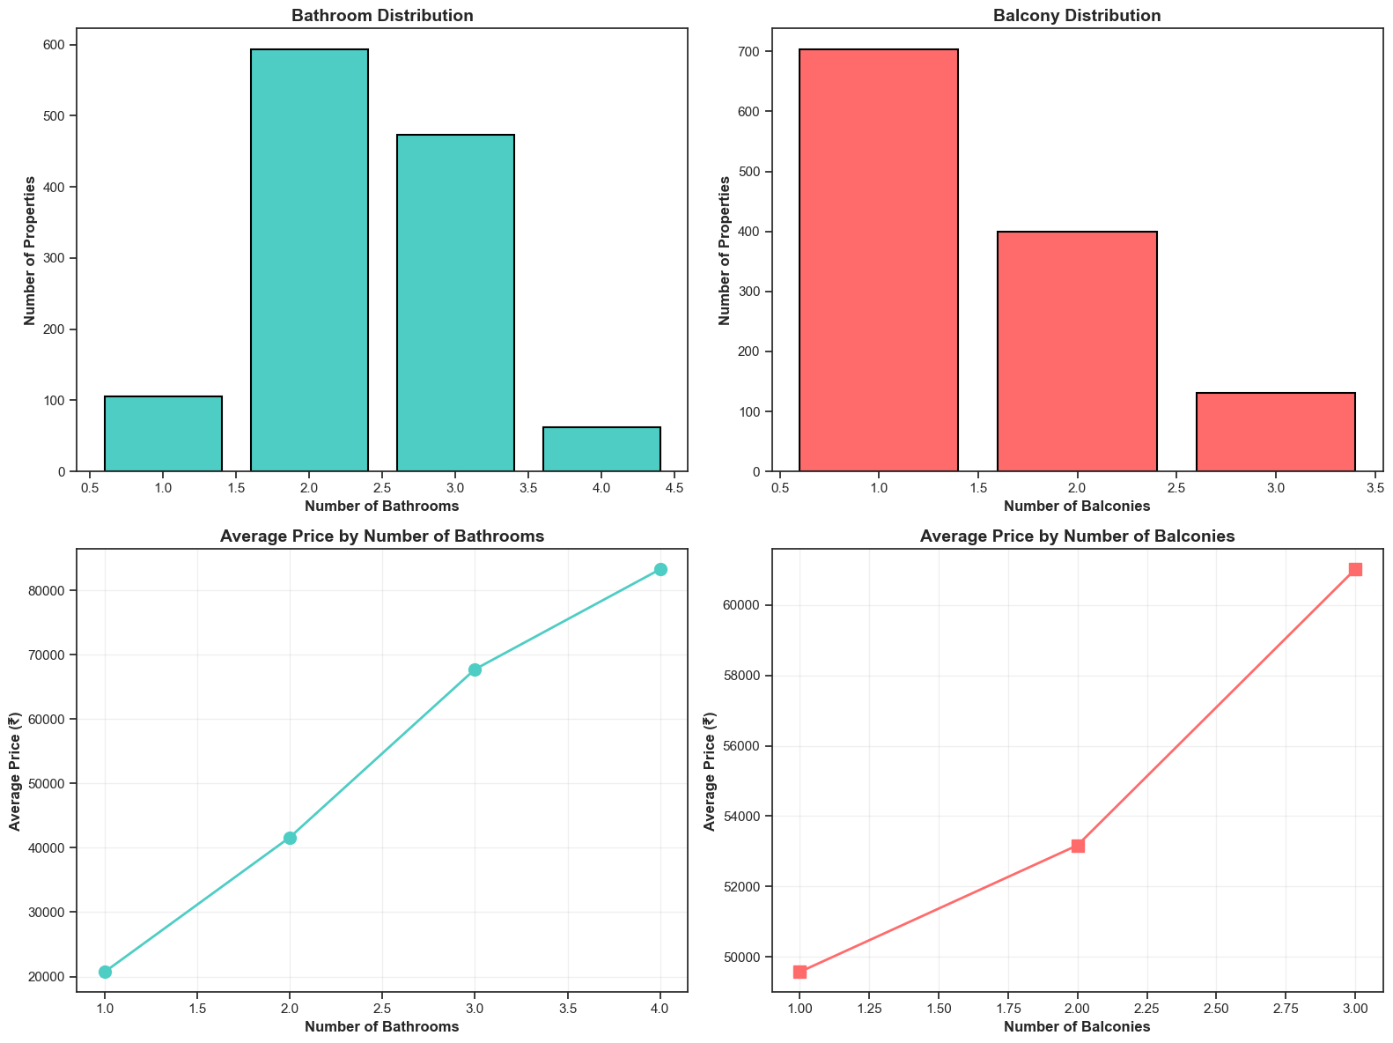
Bathroom and Balcony Analysis

Slide 16
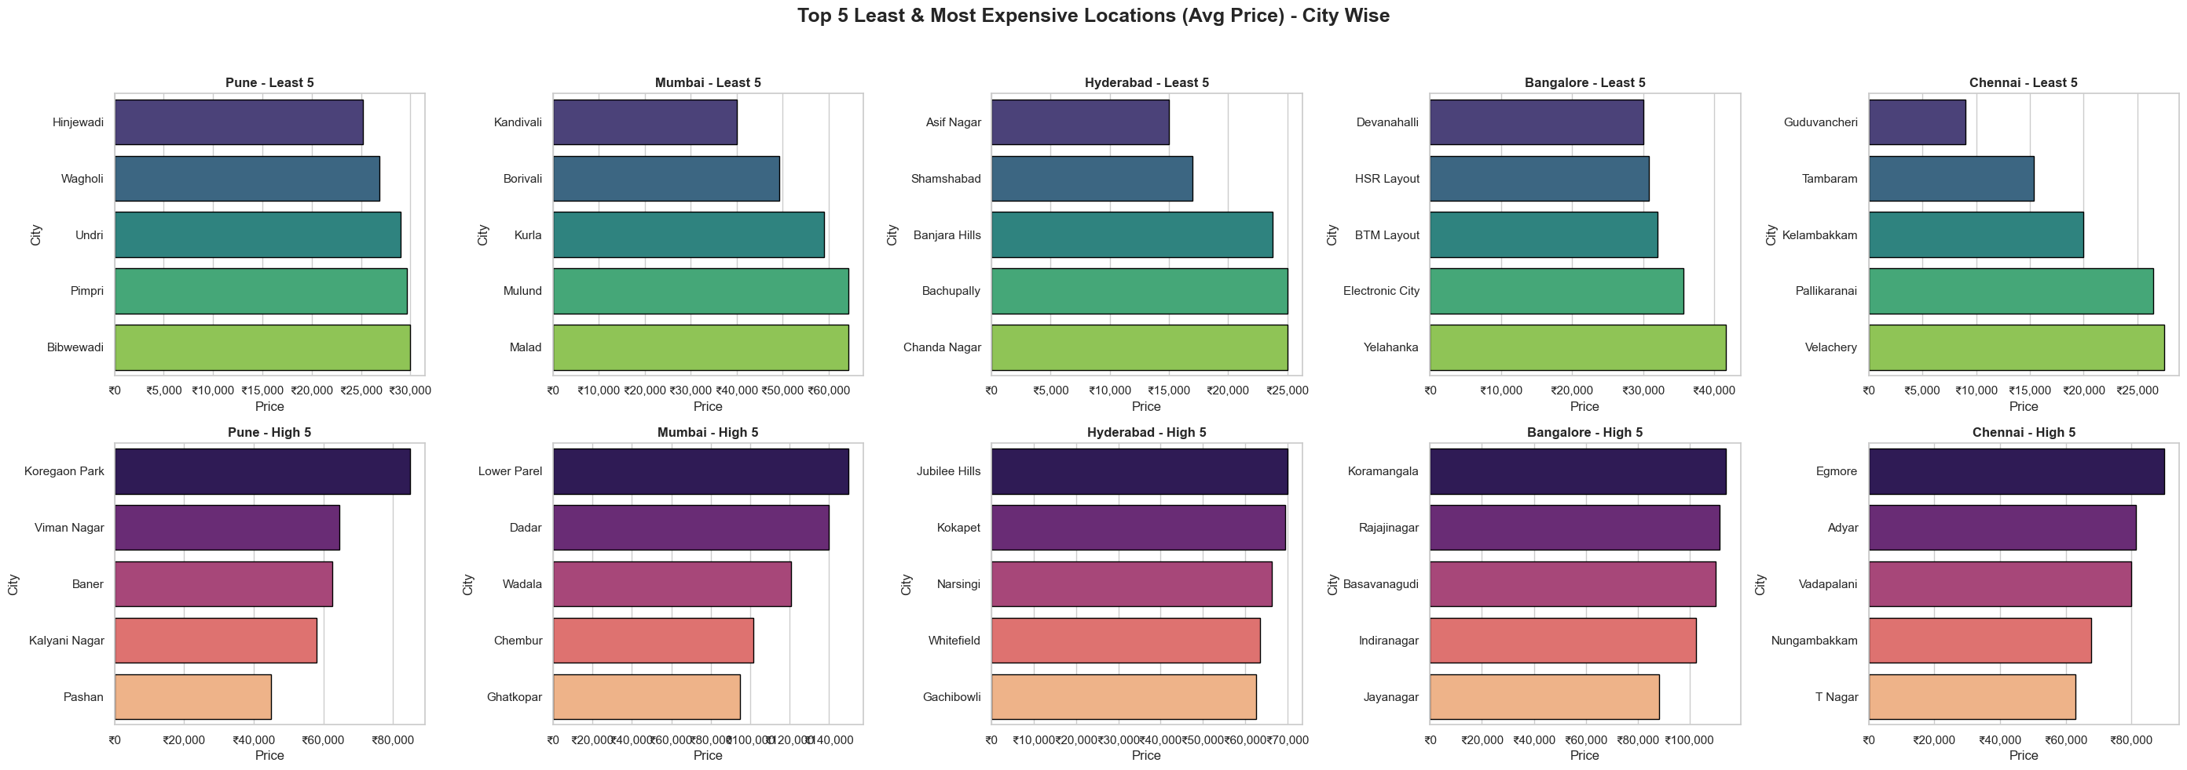
Top 5 Least & Most Expensive Locations (Avg Price) – City Wise

Slide 17
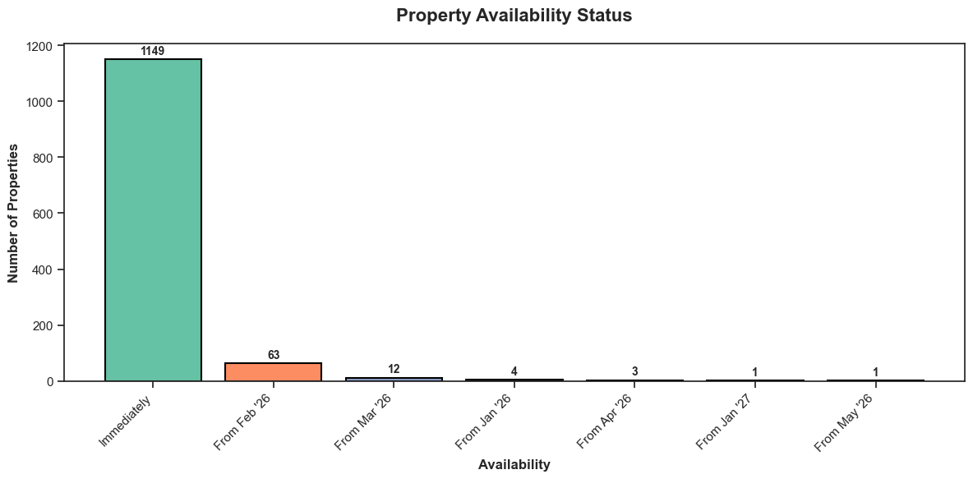
Property Availability Status Analysis

Slide 18
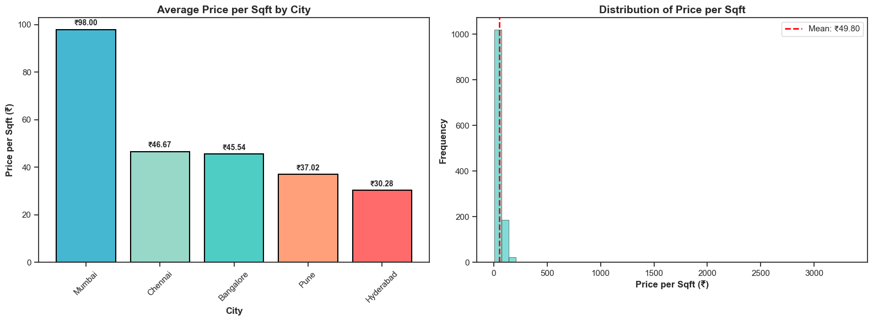
Price per Square Foot Analysis

Slide 19
Conclusion
🏆 Most Expensive City: Mumbai (₹82,709 avg)
💰 Most Affordable City: Pune (₹39,082 avg)
🏠 Most Popular Configuration: 3 BHK (589 properties)
🛋️ Preferred Furnishing: Semi-Furnished (755 properties)
📊 Average Price per Sqft: ₹49.80
👥 Tenant Preference: Bachelors/Family is most common
🏢 Property Type: Flat dominates the market (1058 properties)
Strong correlation between area, BHK, and rental price
Significant price variations observed between cities and configurations
Market shows clear preferences for certain furnishing types
Data-driven insights can help both landlords and tenants make informed decisions

Slide 20
Experience
In this project analyzed rental housing trends across five major Indian cities by scraping and cleaning 1,200+ property listings from MagicBricks using Python. After transforming messy text data into structured numeric form, exploratory analysis revealed key insights like price–area correlation, city-wise rental differences, and furnishing premiums. Visualizations showed that BHK and bathroom count strongly influence rent. Overall, it demonstrated the full data science workflow from data collection to insight generation.

Slide 21
Q&A

Slide 22

THANK YOU

